Slide 1
City of Bell Gardens
Budget Presentation
Fiscal Year 2024 – 2025

Slide 2
Bell Gardens Budget - Overview
FY 23-24 projected surplus of $166K for end of year.
Fiscal 24-25 budget is projected to have surplus of $72K.
FY 24-25 budget includes the approved 3-year labor agreements.
Water Fund continues to run deficits, while a treatment system is designed and funding sources are being identified.

Slide 3
General Fund Projection
FYE June 30, 2024
(FY2023-2024)

Slide 4
FY2023-2024 General Fund Projection
FY2023-2024 | Adopted | Mid-Year | End-of-Year
Revenues | $42,439,425 | $44,249,763 | $44,215,500
Expenditures | $41,704,538 | $44,063,177 | $44,050,000
Surplus/(Deficit) | $734,887 | $186,586 | $165,500

Slide 5
General Fund Projected Fund Balance
Fund Balance at June 30, 2023 | $32,268,000
Projected Change in Fund Balance (FY2023-24) | $165,500
Projected Fund Balance at June 30, 2024 | $32,433,500

Slide 6
General Fund Budget
FYE June 30, 2025
(FY2024-2025)

Slide 7
General Fund Budget FY2024-2025
FY2024-2025 | Presented Budget
Revenues | $46,236,251
Expenditures | $46,163,848
Surplus/(Deficit) | $72,403

Slide 8
General Fund Budget
REVENUES
July 1, 2024 – June 30, 2025
(FY2024-2025)

Slide 9
General Fund Revenues

Slide 10
General Fund Revenue Summary
Revenue Source | FY 23-24 Adopted ($) | FY 24-25 Proposed ($) | Increase/ (Decrease) ($)
Bicycle Casino | 17,952,000 | 19,836,000 | 1,884,000
In Lieu Motor Vehicle | 5,500,000 | 5,665,000 | 165,000
Property Leases | 4,752,000 | 4,910,043 | 158,043
Sales & Use Tax | 3,778,000 | 4,010,213 | 232,213
Measure A-Add on Tax (.75%) | 3,582,000 | 3,762,002 | 180,002
Property Taxes | 1,722,000 | 1,782,472 | 60,472
Charges for Services | 1,030,000 | 1,201,406 | 171,406
Franchise Fees | 910,000 | 950,000 | 40,000
Hotel Visitor Tax | 650,000 | 700,000 | 50,000
Loan Repayments (ROPS) | 748,000 | 770,565 | 22,565
Rental Registry Fees | - | 650,000 | 650,000
Fines and Forfeitures | 480,000 | 500,000 | 20,000
Transfer – In | 396,000 | 407,400 | 11,400
COPS Hiring/Measure H/Tobacco Grant/Post Reimb/LA Impact | 214,000 | 97,850 | (116,150)
Interest Income | 375,000 | 600,000 | 225,000
JPIA Insurance Reimbursement | 110,000 | 113,300 | 3,300
Other Revenues | 85,000 | 200,000 | 115,000
Passport & Photo Frees | 75,000 | 80,000 | 5,000
Food Program | 80,000 | - | (80,000)
Total Revenue | $42,439,000 | $46,236,251 | $3,797,251
Notes:
Highlights:
Bicycle Casino
Transfer-In From Other Funds
Property Leases: Parcel Lease to the Casino; 20% (January 1) from $183,904 per month ($2.391 mill annum) to $220,685 per month ($2.648 mill annum)

Slide 11
General Fund Revenue Composition

Slide 12
Casino Revenues 2012 - 2025

Slide 13
General Fund Budget
EXPENDITURES
July 1, 2024 – June 30, 2025
(FY2023-2024)

Slide 14
General Fund Expenditures
Expenditure Type | FY 23-24 Adopted | FY 24-25 Proposed | FY 24-25 Change
Personnel Services | $27,185,400 | $29,291,337 | $2,105,937
Contractual Services | 10,011,891 | 11,300,885 | 1,288,994
Department Supplies | 1,036,350 | 1,100,300 | 63,950
Capital Outlay | 1,362,500 | 2,415,850 | 1,053,350
Debt Service | 610,464 | 610,465 | 1
Transfer to other Funds | 2,263,121 | 2,563,121 | 300,000
Transfer to Reserves | 200,000 | 200,000 | -
Vacancy Savings Rate | (965,188) | (1,318,110) | (352,922)
Total Expenditures | $41,704,538 | $46,163,848 | $4,459,310
Personnel Services and Contractual Services make up 88% of budget
Notes:
The City is in the business of provided services, either through our employees or through contracts.

Slide 15
General Fund Expenditures Personnel Services (63.5% of Total)
Personnel Services Expenditure | FY2023-24 Proposed | FY2024-25 Proposed | Increase/ (Decrease)
Salaries | $12,915,000 | $13,537,985 | $622,985
CalPERS Retirement | 5,928,400 | 6,394,844 | 466,444
Health Insurance | 2,805,000 | 2,996,345 | 191,345
Part Time | 1,841,000 | 2,317,000 | 476,000
Overtime | 997,000 | 1,173,300 | 176,300
Worker's Compensation | 670,000 | 696,854 | 26,854
Vac/Sick Leave Cash-Outs | 411,000 | 445,000 | 34,000
Holiday Pay | 361,000 | 389,000 | 28,000
Other Benefits | 979,000 | 996,009 | 17,009
Other Taxes | 278,000 | 345,000 | 67,000
Total Personnel Services | $27,185,400 | $29,291,337 | $2,105,937

Slide 16
History of Funded Full-Time Positions By Department
 | Fiscal 16-17 | Fiscal 17-18 | Fiscal 18-19 | Fiscal 19-20 | Fiscal 20-21 | Fiscal 21-22 | Fiscal 22-23 | Fiscal 23-24 | Fiscal 24-25
Council | 1 | 1 | 1 | 1 | 1 | 1 | 1 | 1 | 1
City Manager | 4 | 4 | 4 | 4 | 3 | 3 | 3 | 3 | 3
City Clerk | 2 | 2 | 3 | 3 | 3 | 4 | 5 | 5 | 5
Community Development | 9 | 9 | 9 | 9 | 10 | 11 | 11 | 13 | 16
Finance and Administration | 10 | 10 | 9 | 9 | 9 | 10 | 10 | 10 | 10
Police | 73 | 74 | 74 | 74 | 71 | 73 | 74 | 77 | 77
Public Works | 27 | 28 | 28 | 28 | 28 | 28 | 28 | 30 | 30
Recreation and Community Services | 12 | 12 | 12 | 12 | 11 | 15 | 15 | 15 | 16
Total | 138 | 140 | 140 | 140 | 136 | 145 | 147 | 154 | 158
Notes:
The City has 140 full-time funded positions. No change from the previous year’s total.

Slide 17
Proposed Position Salary Adjustments & Reclassifications FY 2024-2025
Position | Department | Current (Salary) | Proposed (Salary)
Housing Program Supervisor to Housing Program Manager (Reclassification Only) No Fiscal Impact | Community Development | M1-73 Step E $9,076 | M1-73 Step E $9,076
Code Enforcement – Building Inspector to Combination Building Inspector I/II (Reclassification & Salary Adjustment) Hiring point dependent on Experience | Community Development | G2-55 Step A $5,916/Month | G1-63 Step E $6,346/Month
 |  | Total Estimated Personnel Costs | $5,160/Annually

Slide 18
General Fund Expenditures
Contractual Services
July 1, 2024 – June 30, 2025
Contractual Services include: liability insurance, tree and landscape services, warranties and subscriptions, professional services, IT and VOIP services, utilities, animal control, and others.
Contractual Services ($11,300,885 or 24.5%)
Increased by $1,288,994
Increases in Contractual Expenditures
PD contractual services are up by $45K due vehicle maintenance and fuel costs, operational warranties & subscription, professional services - training coordinator. It is experiencing slight savings in Psychological Services as well as other expense levels maintaining steady in other contractual categories.
Public Works’ Administration division contractual services are up by $225K due to higher cost for industrial waste permits, engineering services and crossing guard services.
Public Works’ Park and Facility Maintenance division contractual services are up by $400K due to higher cost for Tree and Landscape services, facility maintenance and repair, equipment rental, contractual services such as Pump Man, Amtech Elevator and plumbing and Janitorial Services.
City Clerk Department contractual services are up by $100K due to upcoming elections costs in FY 2024-25.
Community Development Contractual Services increase of $60K, for Economic Development personnel assistance.
Finance and Admin Contractual Services increase of $50K, for personnel classification study to be completed in FY 24-25.

Slide 19
General Fund Expenditures
Department Supplies
July 1, 2024 – June 30, 2025
Department Supplies: Supplies each respective department needs to run operation and activities for the City. Park supplies, custodial supplies, street supplies, office supplies and recreation supplies.
Department Supplies ($1,100,300 or 2.4%)
Increased by $64K
Expenditures
Departmental Supplies increase and decrease among the various departments, including copier leases increases and range supplies, overall net increase is $64K.

Slide 20
General Fund Expenditures
Capital Outlay
July 1, 2024 – June 30, 2025
Capital Outlay: (One-time purchases) Expenditures to acquire or improve long-term assets. Examples include: Vehicles, Equipment, Furniture, IT Hardware and Software, and Facility Improvements
Total budget is $2.4M or 5.2%
Increase of $1.05M
General Fund Capital Outlay Major Increases and Decreases:
$184K Public Works Administration Vehicles
$50K Police IT Hardware and Software Infrastructure investments
$10K Police Field/Patrol services vehicle investments.
$65K Rec & Community Services Vehicles and Other Equipment
$419K IT Hardware/Software & Other Equipment
$300K General Fund Capital Improvement Projects (Ford Park Access Road, GWMA Recycled Water Project)

Slide 21
General Fund Expenditures
Transfers to Other Funds
July 1, 2024 – June 30, 2025
Transfers Out – General Fund transfers funds to other City funds.
Total Transfer Out to other funds is $2.5 million or 5.5%
Increase of $300K
Transfers Out Changes consist of:
Ford Park Operation Subsidy $115K decrease from previous year
Golf Course Operation Subsidy $50K decrease from previous year
Transfer to Gas Tax $200K increases from previous year
Transfer to Prop A $250K increase from previous year
Transfer to Measure R $15K increase from prior year

Slide 22
General Fund Expenditures
Debt Service
July 1, 2024 – June 30, 2025
Debt Service – Principal and interest payments for bonds and loans received by the City.
Total debt service budget is $610K or 1.3%
2015 Lease Debt Payment $410,000
Energy savings lease purchase agreement $186,000
The City’s total debt as of June 30, 2023
Issue | Balance
2015 Lease Bonds (Principal) | $4,445,000
Compensated Leave | 3,610,130
2004 Water Bond (Principal) | 740,000^{c}
Net Pension Liability | 49,366,418
Retiree Health Liability | 64,812,274
Energy Savings Lease Purchase Agreement (Loan Pymt) | 1,995,409
Total City Debt | $124,969,231
c – paid for by the Water Utility Fund

Slide 23
General Fund Expenditures
By Department
July 1, 2024 – June 30, 2025
(FY2024-25)

Slide 24
General Fund Expenditures by Department FY 2024-2025

Slide 25
General Fund Expenditures by Department
Department | Percent Of Total | FY 23-24 Adopted | FY 24-25 Proposed | Increase/ (Decrease) | Increase/ (Decrease) Explanation
City Council | 0.8% | $344,000 | $351,110 | $7,110 | Increase mainly in Personnel Costs per MOU, CALPERS, Health Care and conference, meeting & travel cost.
City Manager, IT & Telecom | 5.4% | 1,883,000 | 2,512,907 | 629,907 | Increase mainly in Personnel Costs per MOU, CALPERS, Health Care and IT projects.
Legal Services | 2.0% | 725,000 | 925,000 | 200,000 | Increased legal fee rate
City Clerk | 1.8% | 667,000 | 809,444 | 142,444 | Increase mainly in Personnel Costs per MOU, CALPERS, Health Care and up coming election cost.
Community Development | 6.1% | 2,183,538 | 2,794,953 | 611,415 | Increase mainly in Personnel Costs per MOU, CALPERS, Health Care and Permit Software
Finance, HR & Risk Mgmt. | 8.7% | 3,814,000 | 4,017,636 | 203,636 | Increase mainly in Personnel Costs per MOU, CALPERS, Health Care and JPIA Liability Insurance
Police | 42.3% | 19,032,000 | 19,546,901 | 514,901 | Increase in personnel costs per MOU, CALPERS and Health Care. Other increases Maint & Supply, increased contractual Srvs costs.
Public Works | 14.8% | 5,610,000 | 6,834,404 | 1,224,404 | Increase in personnel costs per MOU, CALPERS and Health Care. Other increases Maint & Supply, increased contractual Srvs costs. Software in Capital Outlays
Recreation | 13.2% | 5,338,000 | 6,116,017 | 778,017 | Increase in personnel costs per MOU, CALPERS and Health Care. Offset by decreases in Maint & Supply, Contact Srvs & Capitol Outlays
Debt Service | 1.3% | 610,000 | 610,465 | 465 | Increase maturity of the loan payment
Transfers | 6.0% | 2,263,000 | 2,763,121 | 500,121 | Increase in Subsidy to Ford Park and Golf Course. Higher Payment From Successor Agency to City resulting in higher transfer to Fund (181) Equipment Replacement Fund;
Transfers for Reserve | 0.4% | 200,000 | 200,000 | - | Yearly Transfer for Contingency
Vacancy Savings Rate | -2.9% | (965,000) | (1,318,110) | (353,110) | Applied 4.5% savings in FY24-25, 8 Current Vacancies noted.
Total Expenditures | 100% | $41,704,538 | $46,163,848 | $4,459,310

Slide 26
FY 2024-2025 Budget
Capital Improvement Projects

Slide 27
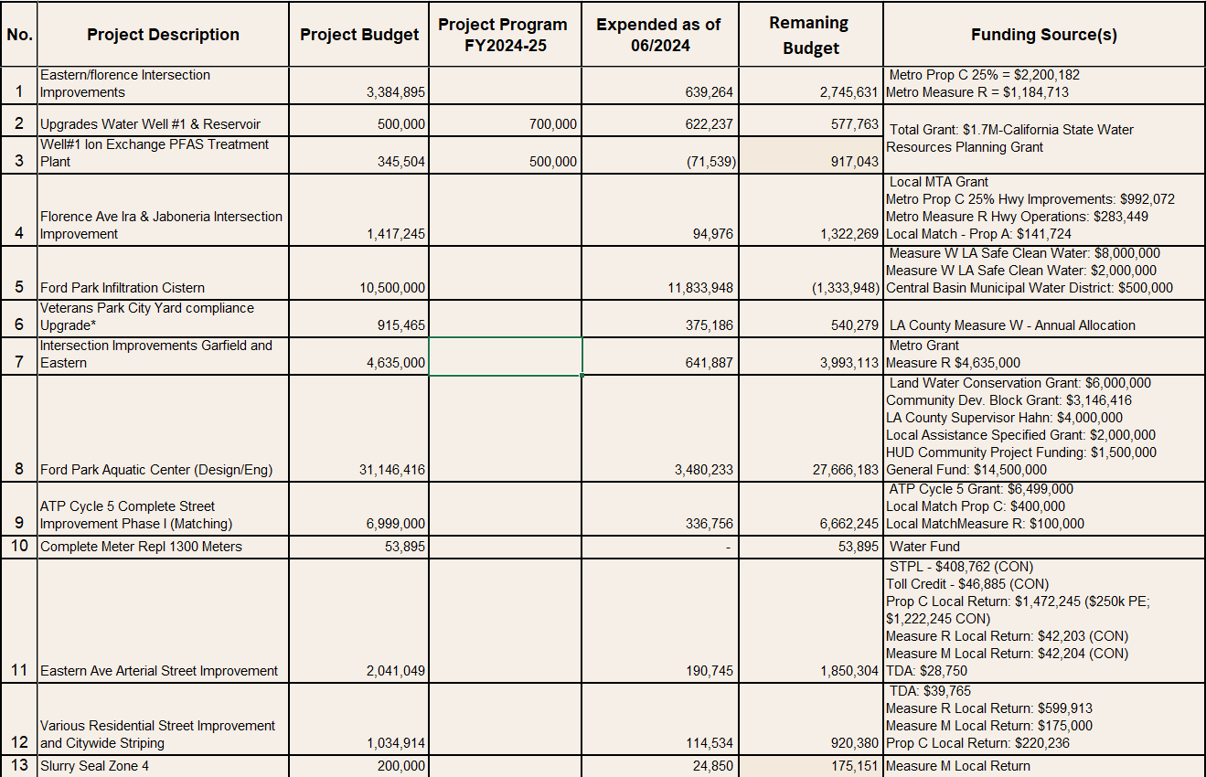
Capital Improvement Projects FY2024-2025

Slide 28
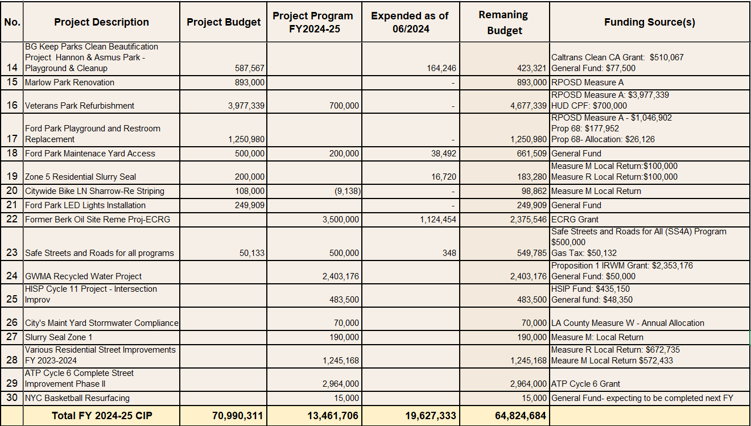
Capital Improvement Projects FY2024-2025
*- accordance with the City’s purchasing policy, each project over $10,000 will be brought before the City Council for approval

Slide 29
FY 2024-2025 Budget
All City Funds

Slide 30
All City Funds
For fiscal 2024-2025, the proposed expenditures for all thirty-five (35) City funds is $78,205,327.
Fund Type (Number of Funds) | FY2024-2025 Proposed Expenditures
General Fund (1) | $46,163,848
Equipment Replacement Funds – General Fund in ACFR (1) | 60,000
Special Revenue Funds (23) | 14,051,406
Capital Project Funds (2) | 11,722,326
Enterprise Funds (Water and Golf) | 3,615,007
Successor Agency Funds (6) | 2,592,740
Total All City Funds | $78,205,327

Slide 31
Water Utility Fund
By the end of FY 2023-2024, the Water Utility’s cumulative deficit is projected to increase by $1,105,000. In FY 2024-25, the Water Utility is projected to lose another $1,259,000. To cover the cash deficit, the Water Utility borrows funds from the General Fund. By the end of FY 2024-25, the Water Utility is projected to owe the General Fund $8,669,000.
Water Utility Fund | FY2024-2025 Projected
Estimated Revenues | $1,988,000
Proposed Expenditures | $3,247,000
Budget Surplus/(Deficit) | ($1,259,000)

Slide 32
Bell Gardens Budget - Summary
FY 23-24 projected surplus of $166K for end of year.
Fiscal 24-25 budget is projected to have surplus of $72K.
FY 24-25 budget includes the approved 3-year labor agreements.
Water Fund continues to run deficits, while a treatment system is designed and funding sources are being identified.
All Employee MOU’s, Contracts and Purchases over $10K are presented to City Council for approval throughout the FY.

Slide 33
City of Bell Gardens
Q & A

